Slide 1

History Of Computing & Computer Architecture
Group – 1 (Presentation)
Twinkle Private University

Slide 2
Topics
History Of Computers
Generation Of Computers
Computer Components
Operating System
Computer System Networkings

Slide 3
Computing History
1822
1976
Steve Job & Steve Wozink (Co-Founder of Apple)released the version of the computer with Single Circuit board and ROM
The Original Window 1 was started in November by the founder Bill Gates
2023
The Latest Version Of Window 11 released ,The Linux Version ,Chrome OS , Mac IOS & Ubuntu , Andriod OS
The First Computer in History Created By Charles Babbage The ABC(Name of Very First PC)
1985

Slide 4
Generations Of Computing in History
1 - The first generation computers were developed by using vacuum tube or thermionic valve machine also known as valves .The input of this system was based on punched cards and paper tape; however, the output was displayed on printouts.
2 - The period of second generation was from 1959-1965. In this generation, transistors were used that were cheaper, consumed less power, more compact in size, more reliable and faster than the first generation machines made of vacuum tubes.
3 - The period of third generation was from 1965-1971. The computers of third generation used Integrated Circuits (ICs) in place of transistors. A single IC has many transistors, resistors, and capacitors along with the associated circuitry.
4 - Fourth Generation of computers was between 1971 – 1980. These computers used the VLSI technology or the Very Large Scale Integrated (VLSI) circuits technology. Therefore they were also known as the microprocessors. Intel was the first company to develop a microprocessor.
1 – 1st Generation
2 – 2nd Generation
3 – 3rd Generation
4 – 4th Generation

Slide 5
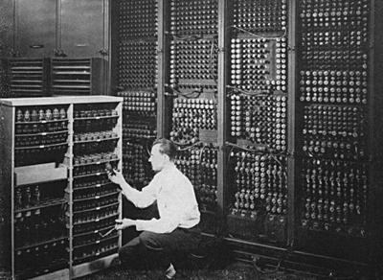
Computer Architecture In History
In early before time today ,computing is used for work. In middle of 19th centuries ,people use personal for their for their personal use such as playing games & doing office works .Then we developed applications like calendars , alarms and
planners and so on .At the time of 1950s and 1960s ,governments and university were using more computers heavily .Because by using these specific caculations ,we can save our time.If we give rigit numbers and equations ,they won’t give us wrong answers.So by using them ,they will show the absolute caculations that we never had before.
First Computer In Early 19s

Slide 6
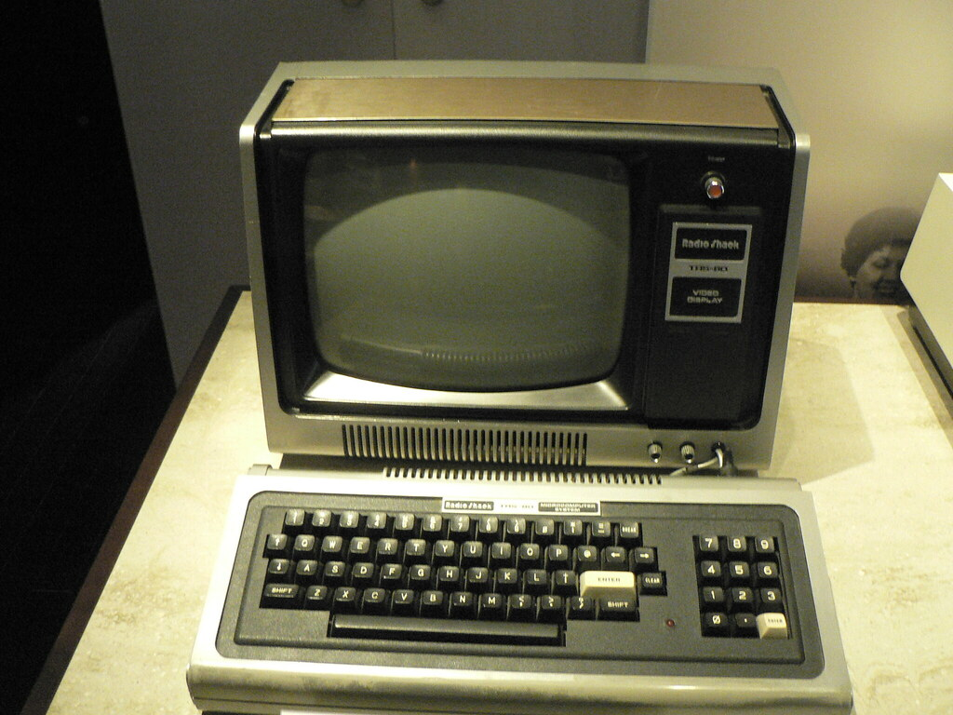
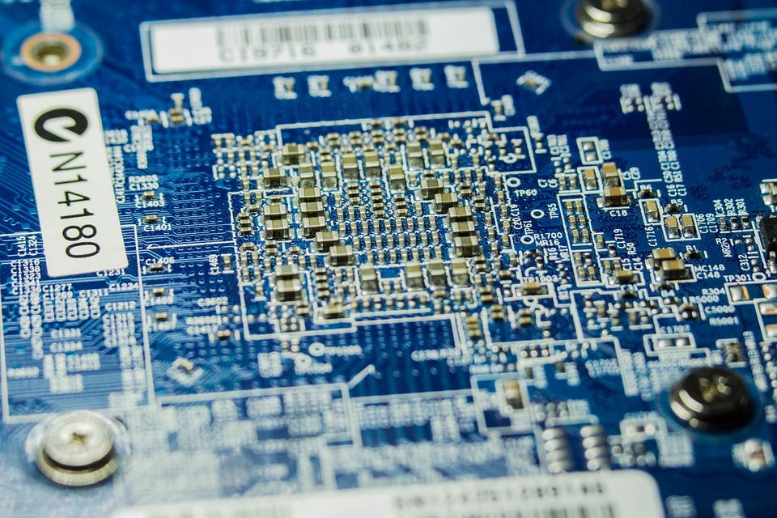
Illustrations of Computer Generations 1 & 2
Generation 1 – Valve Type PC
Generation 2 – Transistors Type PC
This Photo by Unknown Author is licensed under CC BY

Slide 7
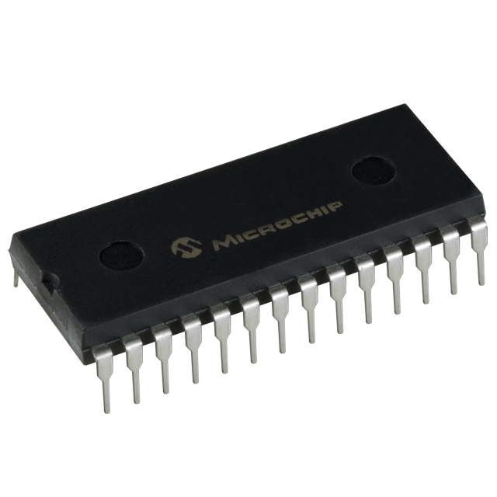
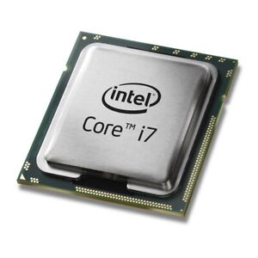
Illustrations Of Computer Generations 3 & 4
Generation 3 – Integrated Circuit Type PC
Generation 4 – Microprocessor Type PC

Slide 8
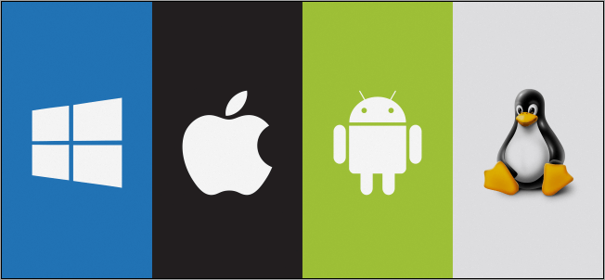
Operating systems
Microsoft Windows
Mac OS
Andriod OS
Linux
Ubuntu
Chrome OS
Fedora

Slide 9
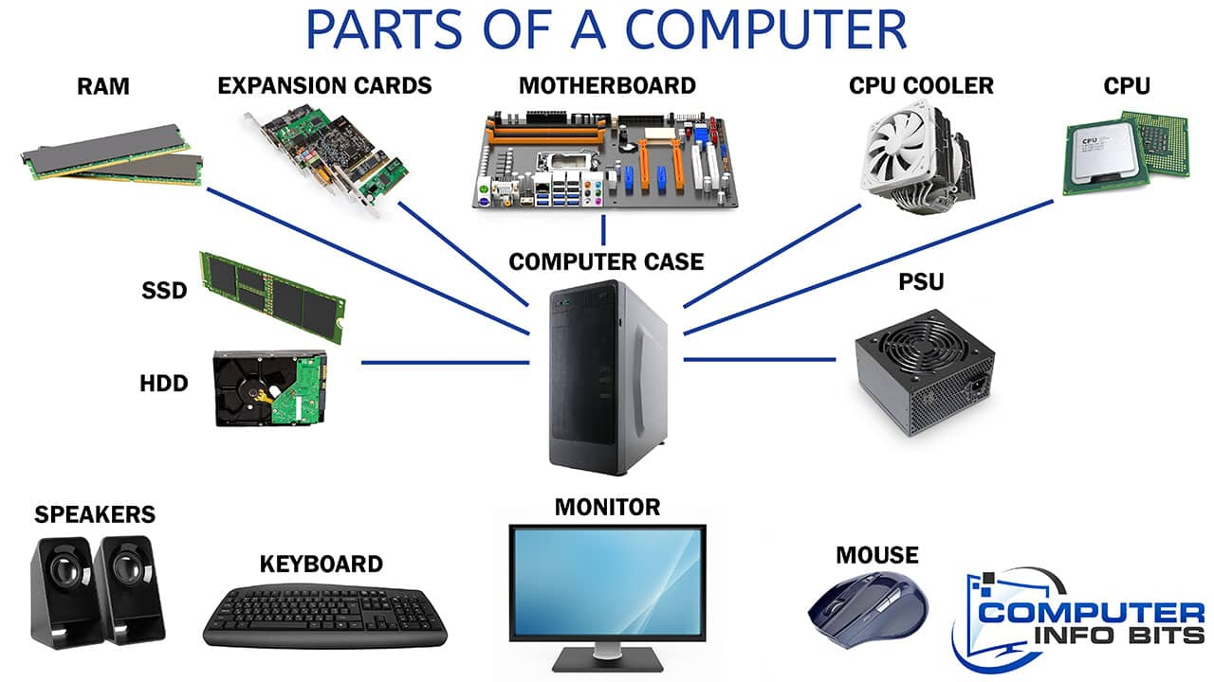
PC Compatible Systems

Slide 10
Everything About CPU
CPU is like a warhouse ,it can stored many programs on its own data.It controls the computer systems like ROM,RAM & secondary storage . But CPU can’t perfrom subtraction.
It can only repeated instead .
It can do floating point numbers but the process would be slower.
Components of CPU are
PC ( Program Counter )
MBR (Memory Buffer Register )
MAR (Memory Address Register )
IR ( Instruction Register )
TEMP ( General Purpose Register )

Slide 11
Reduced Instruction Set Computer ( RISC )
Utilize the small,highly-optimized set of instruction architectures rather than other types of archetectures
RISC designed CPUs can do less but they can execute more rapidly
RISC processors are increased by increasing the register set & the no. of parallel threads & the speed of CPU’s executing instructions .
Complex Instruction Set Computer ( CISC )
A complete architecture in which a single instruction can execute many low-level operations
CISC Architectures are designed with complex designs of mainframe in which memory load & store operations are not separated away.

Slide 12
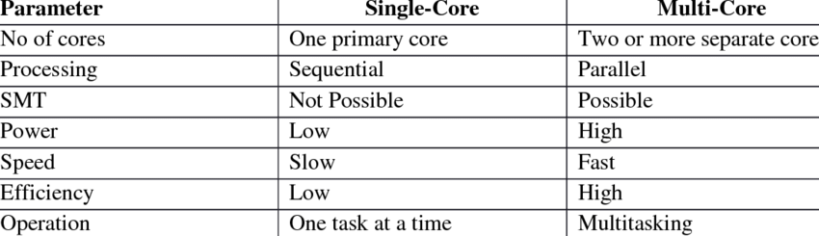
Single vs Multi Core Processors
A CPU that offers multiple cores may perform significantly better than a single-core CPU of the same speed.

Slide 13
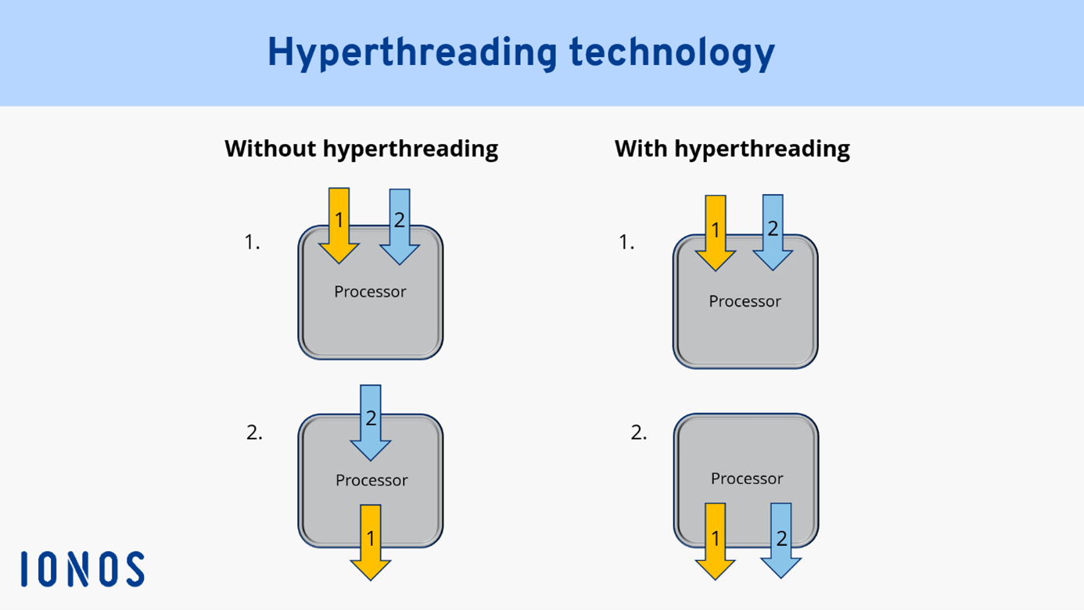
Hyperthreading
Hyper-Threading is an Intel® hardware innovation that allows multiple threads to run on each core, this means more work can be done in parallel.

Slide 14
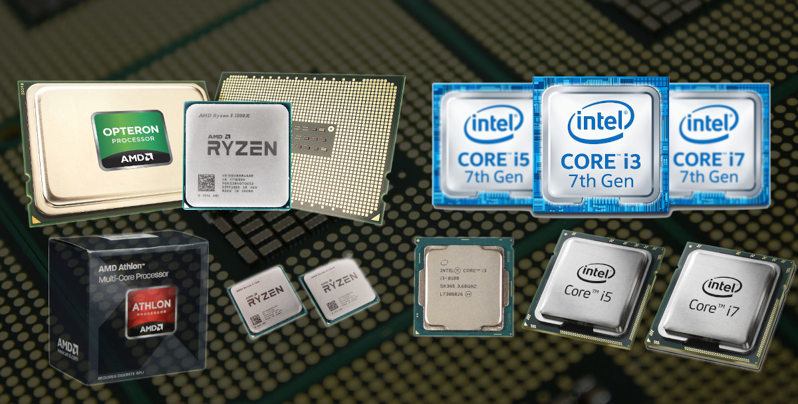
Multi-processor Computers
Multiprocessing is the utilization of two or more central processing units (CPUs) in a single computer system.

Slide 15
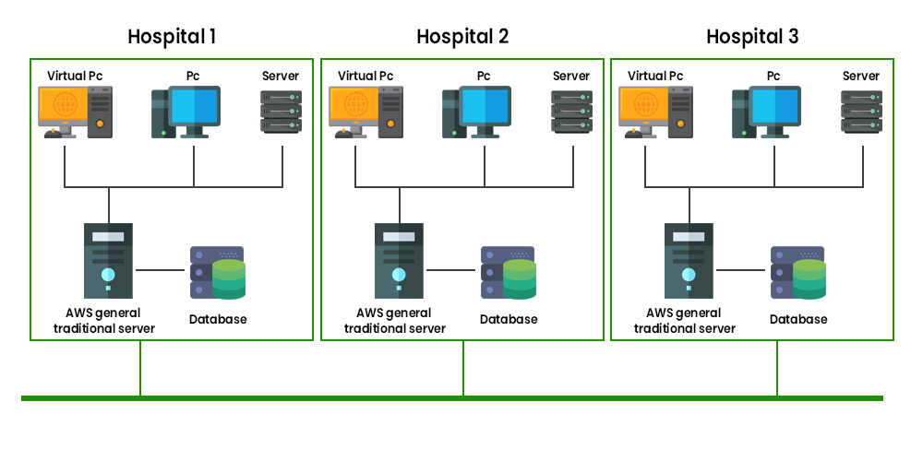
Distributed Computing
Multiple Computers work together to solve a common problem
As a powerful single computer
Need Large-scale resources to deal with complex challenges
Advantages
Availability
Consistory
Transprency
Efficiency

Slide 16
Thank you Everyone !
Any Questions ??

